Slide 1
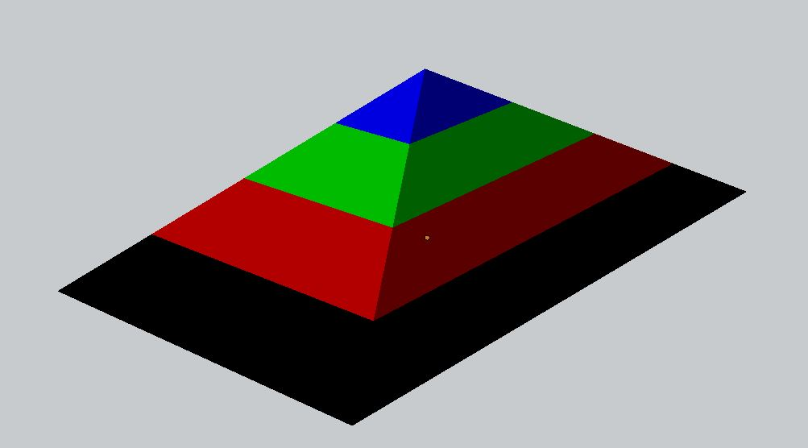

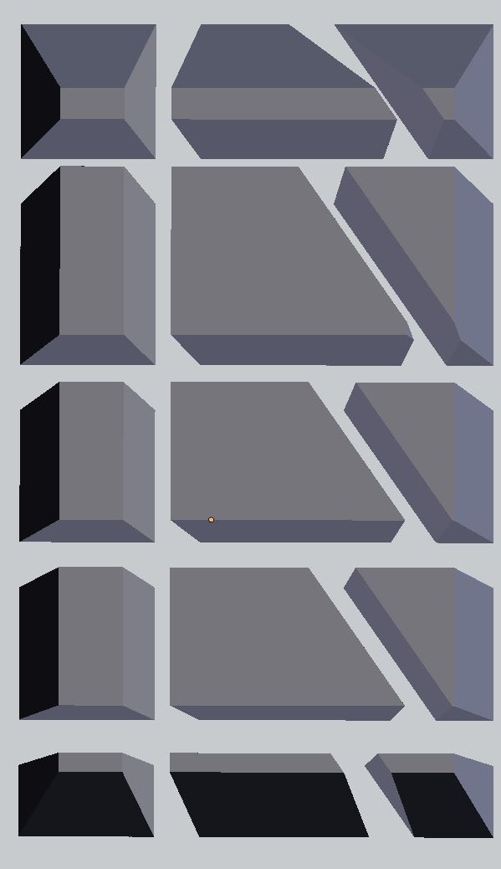
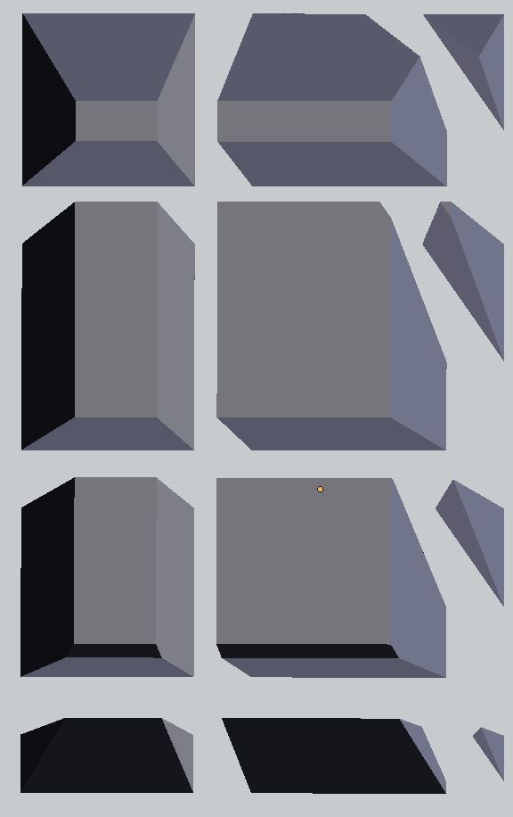
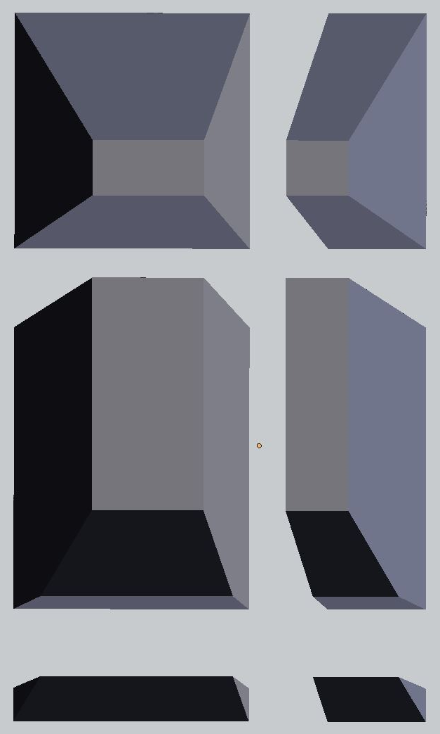
C 0:
977
C 1:
141
(E) Chunk Configuration
Layer 3
(A) Pyramid Layers
C 0:
1573
C 1:
2209
C 2:
1220
C 0:
1579
C 1:
1937
C 2:
158
C 3:
2519
C 4:
3847
C 5:
2021
C 3:
2528
C 4:
3306
C 5:
266
C 0:
1573
C 1:
776
C 1:
2450
C 2:
1251
C 6:
2070
C 7:
3163
C 8:
1662
C 6:
2079
C 7:
2763
C 8:
174
C 9:
2068
C 10:
3163
C 11:
1662
C 3:
166
C 4:
73
C 9:
528
C 10:
649
C 11:
29
(D) Chunk Configuration
Layer 2
C 12:
929
C 13:
1274
C 14:
777
(C) Chunk Configuration
Layer 1
(B) Chunk Configuration
Layer 0

